Slide 1



Bachelor of Accounting & Finance (Hons)
FIN2224 Financial Accounting 2
Ratio Analysis

Slide 2

Learning Objective (s)
How to analyze and interpret financial statements.
Learn how to calculate ratios using formulas

Slide 3
Learning Outcome (s)
At the end of this lesson, students must be able to:
Describe the different types of ratios
Interpret and analyze company accounts using appropriate ratios

Slide 4
TOPICS
Comparative analysis
Tools used in financial statement analysis
Horizontal analysis
Vertical analysis
Liquidity, profitability, solvency & efficiency ratios

Slide 5
Financial statements analysis
A process of selecting, evaluating, and interpreting financial statements data in order to formulate an assessment of a company’s financial condition and performance.
These analysis may be used in decision making.

Slide 6
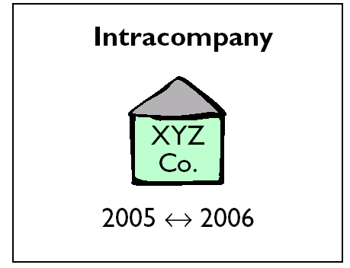
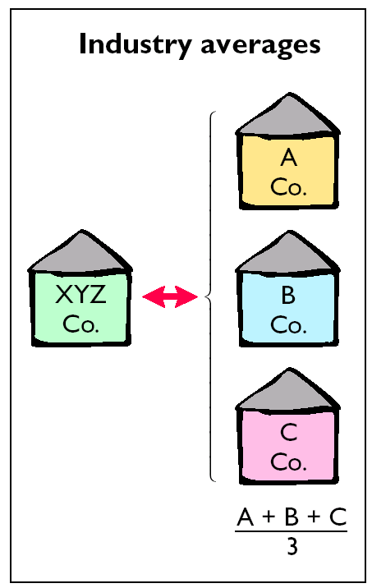
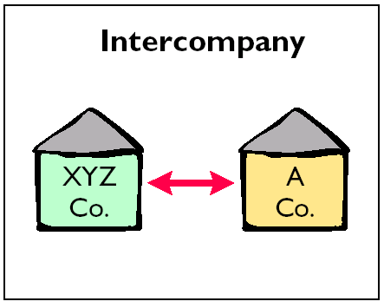
COMPARATIVE ANALYSIS

Slide 7
ANALYSIS TOOLS
HORIZONTAL (TREND) ANALYSIS
evaluates a series of financial statements
data over a period of time.
VERTICAL ANALYSIS
expresses each item
in a financial statements
as a percent of a base amount.
RATIO ANALYSIS
expresses the relationship among
selected items of financial statements data.
Notes:
4

Slide 8
HORIZONTAL ANALYSIS
Changes are measured
against a base year with
the following formula.
Change since base period

Slide 9
VERTICAL ANALYSIS
Financial statement elements are
measured as a percent of the total.
Balance Sheet
Income Statement
Elements are a
percent of total assets
Elements are a
percent of total sales

Slide 10
Ratio Analysis - Definition and Concept
Financial ratio is mathematical explanation of the relationship between two items and is used to interpret the business account.
A tool to provide unique picture and understanding of a company’s financial position such as the strengths and weaknesses of a company.
To make a ratio meaningful, both figures used must have a logical or cause and effect relationship.

Slide 11
Ratios Comparison
To make it more valuable, ratios are analysed through a comparison process such as:
Comparison with the standard
Comparison with predetermined result
Comparison with the direct competitor
Comparison with the previous period performance / results / targeted performance

Slide 12
Importance Of Ratio Analysis
Absolute figures are often misleading. They are meaningful and useful only when they are compared with –
a. Past performance of the same company
b. Performance of competitors
c. Budgeted figures
d. Averages of the industry
e. Standards developed by analyst
A ratio shows arithmetical relationship between two figures. With the help of financial ratios, make decision, assessment and judgement can be reached about the financial health and performance of a company.

Slide 13
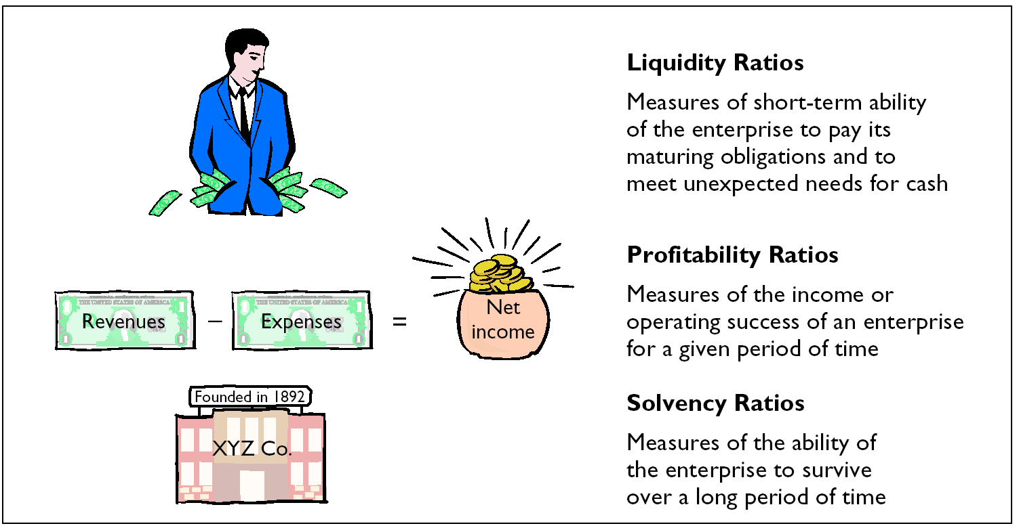
Common type of Ratio Analysis

Slide 14
Liquidity Ratio
Current ratio
Used to test the overall liquidity of a company and short term debt-paying liability.
It indicates how many times current liabilities are being covered by current assets.
The higher, the better.
Formula:
Current ratio =
Current assets
Current liabilities

Slide 15
Liquidity Ratio cont.
Acid test ratio (Quick ratio)
To show the ability of the business to pay all its current liabilities from liquid resources.
Better in measuring liquidity than current ratio.
The higher, the better.
Formula:
Quick ratio =
Current assets – Inventory
Current liabilities

Slide 16
Activity / Efficiency Ratio
Inventory turnover
The number of times the average inventory have been replaced during a given accounting period.
Measures how efficient inventory is being managed by a business.
The higher, the better.
Formula:
Inventory turnover =
But, how to find average inventory??
Average inventory =
OR in days,
Inventory Turnover days = closing inventory
cost of sales/purchase/sales x 365 days
Cost of goods sold
Average inventory
Opening inventory + Closing inventory
2

Slide 17
Activity / Efficiency Ratio cont.
Average collection period/Debtors turnover/collection
Measure effectiveness of its credit control and collection policies.
The shorter, the better.
Formula:
ACP =
In case information about credit sales is not available total sales may be assumed to be credit sales.
Account receivable | x 365 days
Net credit sales

Slide 18
Activity / Efficiency Ratio cont.
Average payment period/Payable turnover/payment
Measure effectiveness of its payment policies.
The shorter, the better.
Formula:
APP =
In case information about credit purchase is not available total purchase may be assumed to be credit purchase.
Account payable | x 365 days
Net credit purchases

Slide 19
Activity / Efficiency Ratio cont.
Net Assets Turnover
Measure effectiveness of its assets to generate income
The higher, the better
Formula:
NAT =
Net Assets
Revenue/Turnover

Slide 20
Activity / Efficiency Ratio cont.
FIXED Assets Turnover
Measure effectiveness of its fixed assets only to generate income
The higher, the better
Formula:
FAT =
Fixed Assets
Revenue/Turnover

Slide 21
Profitability Ratio
Gross profit margin
Measuring what proportion of revenue is converted into gross profit.
The higher, the better.
Formula:
GP ratio =
Gross Profit | x 100
Net sales

Slide 22
Profitability Ratio cont.
Net profit margin
It represents the proportion of sales that is left over after all relevant expenses have been adjusted.
The higher, the better.
Formula:
NP ratio =
Net profit | x 100
Net sales

Slide 23
Profitability Ratio cont.
Return on capital employed.
Measures how efficient the capital has been used or employed by the business to generate income.
The higher, the better.
Formula:
ROCE =
But how to find capital employed? You can use average or closing
Average capital employed =
Capital = Non current asset + current assets – current liabilities
Net profit | x 100
Capital employed
Opening capital + Closing capital
2

Slide 24
Profitability Ratio cont.
Return on assets or Net Assets
Measures efficiency of the business in using its assets to generate net income.
The higher, the better.
Formula:
ROA =
Net profit
Total assets or Net Assets

Slide 25
Profitability Ratio cont.
Return on equity
Ratio of net income of a business during a year to its stockholders' equity during that year.
It is a measure of profitability of stockholders' investments.
The higher, the better.
Formula:
ROE =
Net profit
Shareholders’ Equity

Slide 26
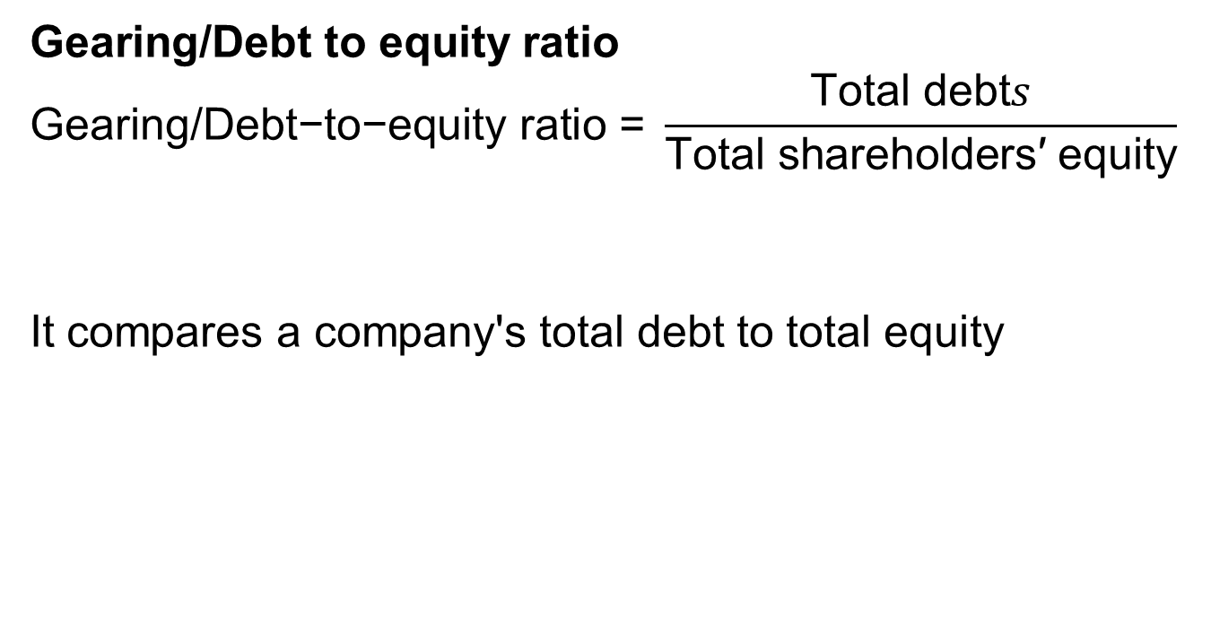
Solvency Ratio
Gearing/Debt to equity ratio
$$\text{Gearing}\text{/}\text{Debt}\text{−}\text{to}\text{−}\text{equity} \text{ratio}\text{ = }\frac{\text{Total} \text{debt}s}{\text{Total} \text{shareholders}\text{′ }\text{equity}}$$
It compares a company's total debt to total equity

Slide 27
Solvency Ratio
Interest cover
Measures the ability to meet interest payments as they are due.
Formula:
Profit before Income Taxes and Interest Expense
Interest Expense

Slide 28
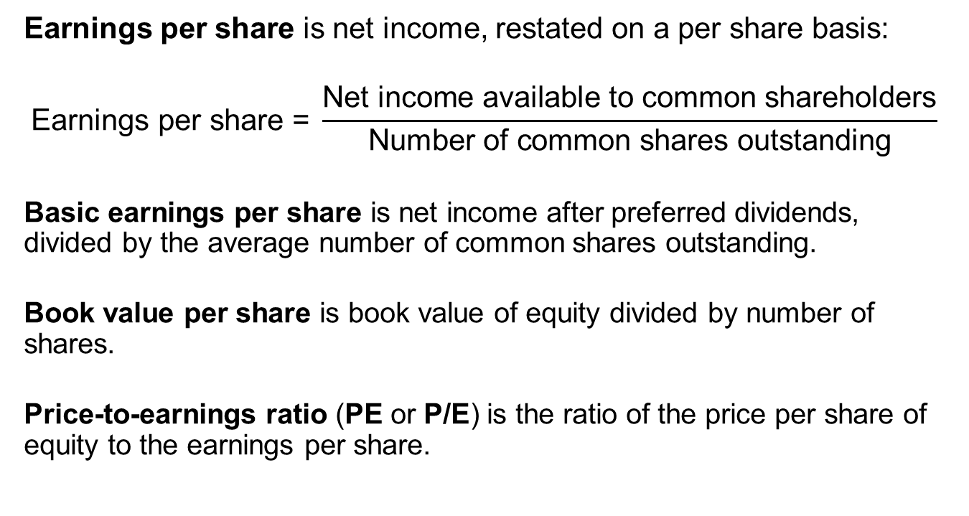
Other Ratios
Earnings per share is net income, restated on a per share basis:
$$\text{Earnings} \text{per} \text{share}\text{ = }\frac{\text{Net} \text{income} \text{available} \text{to} \text{common} \text{shareholders}}{\text{Number} \text{of} \text{common} \text{shares} \text{outstanding}}$$
Basic earnings per share is net income after preferred dividends, divided by the average number of common shares outstanding.
Book value per share is book value of equity divided by number of shares.
Price-to-earnings ratio (PE or P/E) is the ratio of the price per share of equity to the earnings per share.
Notes:
LOS: Calculate and interpret basic earnings per share and diluted earnings per share.
LOS: Calculate and interpret book value of equity per share, price-to-earnings ratio, dividends per share, dividend payout ratio, and plowback ratio.
Pages 383–385
Other Ratios
Earnings per share is net income, restated on a per share basis:
$$\text{Earnings} \text{per} \text{share}\text{ = }\frac{\text{Net} \text{income} \text{available} \text{to} \text{common} \text{shareholders}}{\text{Number} \text{of} \text{common} \text{shares} \text{outstanding}}$$
Basic earnings per share is net income after preferred dividends, divided by the average number of common shares outstanding.
Diluted earnings per share is net income minus preferred dividends, divided by the number of shares outstanding considering all dilutive securities.
Book value per share is book value of equity divided by number of shares.
Price-to-earnings ratio (PE or P/E) is the ratio of the price per share of equity to the earnings per share.
If earnings are the last four quarters, it is the trailing P/E.

Slide 29
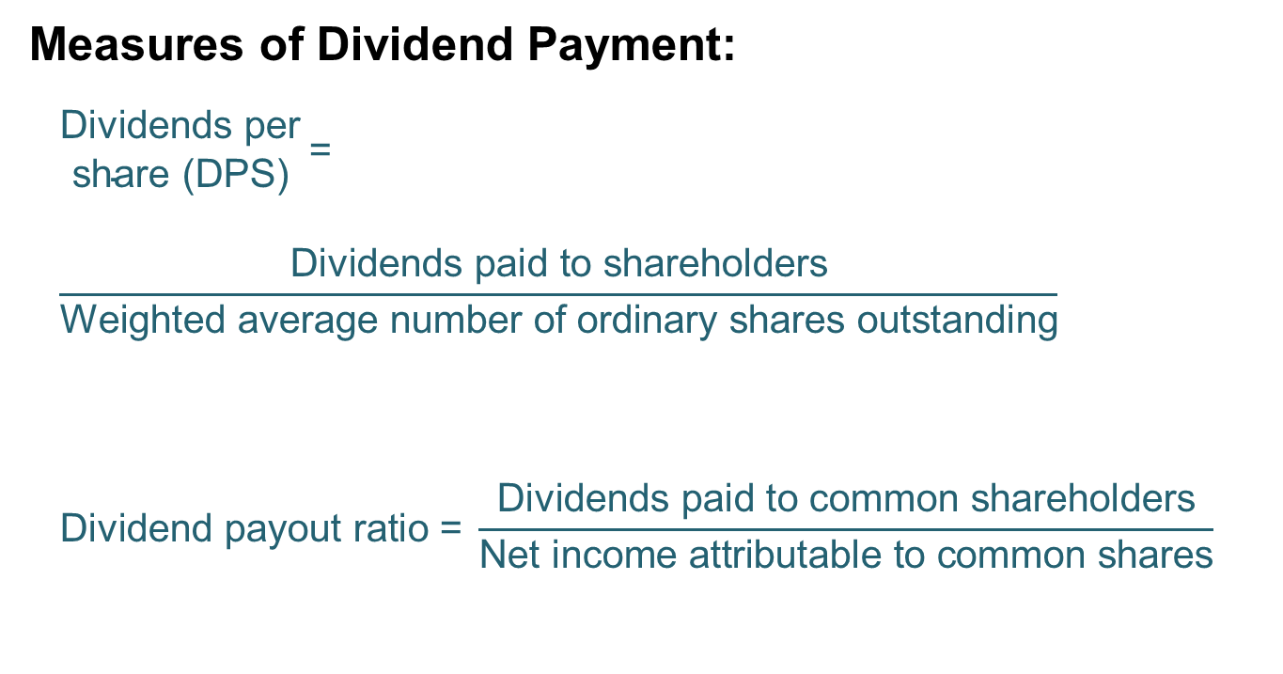
Other Ratios
Measures of Dividend Payment:
$$\begin{matrix}\text{D}\text{ividends} \text{per} \\ \text{share}\text{ (}\text{DPS}\text{)}\end{matrix} \text{= }\frac{\text{Dividends} \text{paid} \text{to} \text{shareholders}}{\text{Weighted} \text{average} \text{number} \text{of} \text{ordinary} \text{shares} \text{outstanding}}$$
$$\text{Dividend} \text{payout} \text{ratio}\text{ = }\frac{\text{Dividends} \text{paid} \text{to} \text{common} \text{shareholders}}{\text{Net} \text{income} \text{attributable} \text{to} \text{common} \text{shares}}$$
Notes:
LOS: Calculate and interpret book value of equity per share, price-to-earnings ratio, dividends per share, dividend payout ratio, and plowback ratio.
Pages 383–385
Other Ratios
Measures of Dividend Payment:
$$\begin{matrix}\text{D}\text{ividends} \text{per} \\ \text{share}\text{ (}\text{DPS}\text{)}\end{matrix}\text{= }\frac{\text{Dividends} \text{paid} \text{to} \text{shareholders}}{\text{Weighted} \text{average} \text{number} \text{of} \text{ordinary} \text{shares} \text{outstanding}}$$
$$\text{Dividend} \text{payout} \text{ratio}\text{= }\frac{\text{Dividends} \text{paid} \text{to} \text{common} \text{shareholders}}{\text{Net} \text{income} \text{attributable} \text{to} \text{common} \text{shares}}$$
Plowback ratio = 1 – Dividend payout ratio
The proportion of earnings retained by the company.

Slide 30
Example: Shareholder ratios
Calculate the book value per share, P/E, dividends per share and dividend payout based on the following financial information:
Book value of equity | $100 million
Market value of equity | $500 million
Net income | $30 million
Dividends | $12 million
Number of shares | 100 million
Notes:
LOS: Calculate and interpret book value of equity per share, price-to-earnings ratio, dividends per share, dividend payout ratio, and plowback ratio.
Pages 383–385
Example: Shareholder Ratios
Calculate the book value per share, P/E, dividends per share, dividend payout, and plowback ratio based on the following financial information:
Book value of equity $100 million
Market value of equity $500 million
Net income $30 million
Dividends $12 million
Number of shares 100 million

Slide 31
Example: Shareholder Ratios
Book value per share | $1.00 | There is $1 of equity, per the books, for every share of stock.
P/E | 16.67 | The market price of the stock is 16.67 times earnings per share.
Dividends per share | $0.12 | The dividends paid per share of stock.
Dividend payout ratio | 40% | The proportion of earnings paid out in the form of dividends.
Notes:
LOS: Calculate and interpret book value of equity per share, price-to-earnings ratio, dividends per share, dividend payout ratio, and plowback ratio.
Pages 383–385
Example: Shareholder Ratios
Book value per share = $1.00
There is $1 of equity, per the books, for every share of stock.
P/E = 16.67
The market price of the stock is 16.67 times earnings per share.
Dividends per share = $0.12
The dividends paid per share of stock.
Dividend payout ratio = 40%
The proportion of earnings paid out in the form of dividends.
Plowback ratio = 60%
The proportion of earnings retained by the company.

